Slide 1
Business Process – Accounts Payable

Slide 2
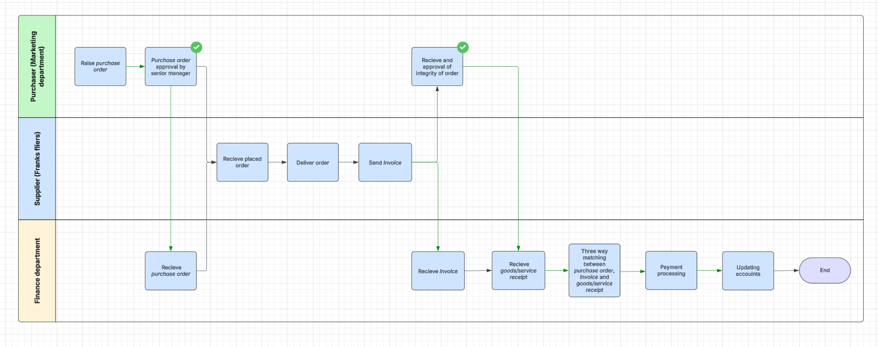
Accounts Payable Business Process 1.0

Slide 3
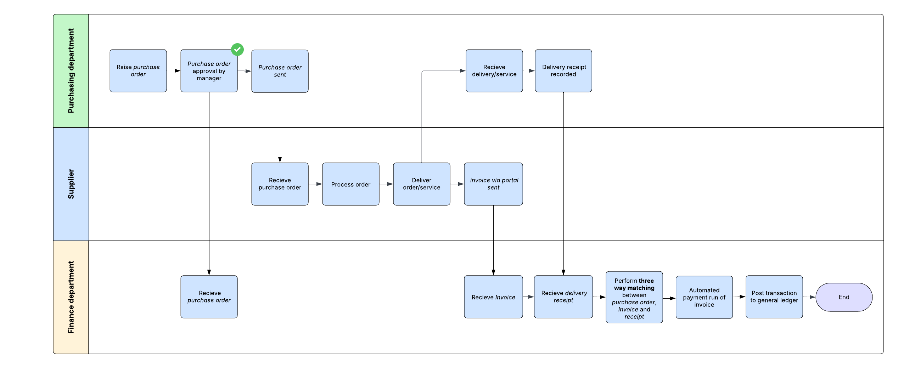
Accounts Payable Business Process 1.1

Slide 4
System Design

Slide 5
At a glance

Slide 6
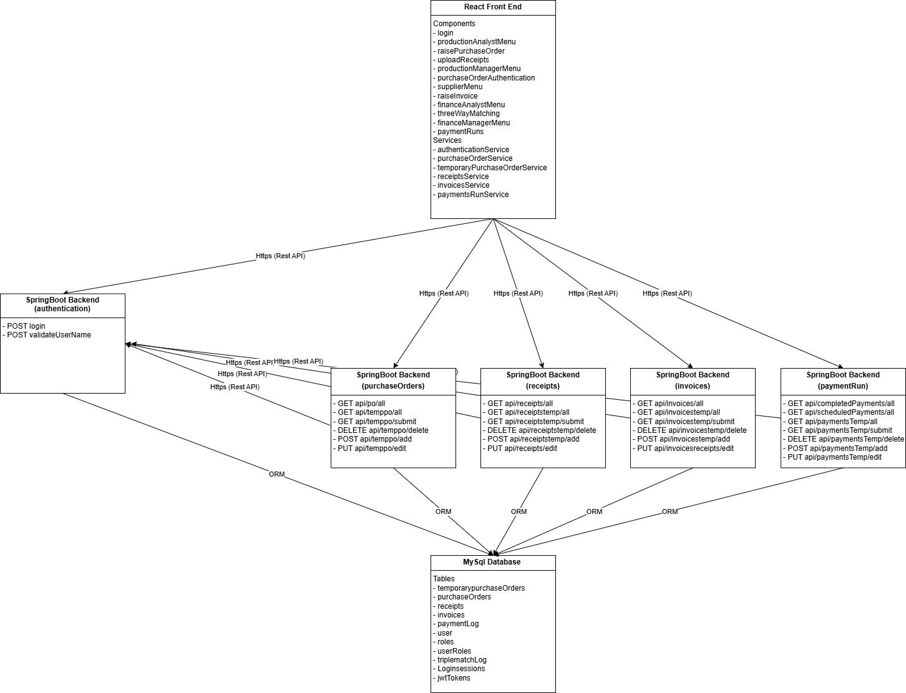
Web Application Component Diagram 1.0

Slide 7
Database Design

Slide 8
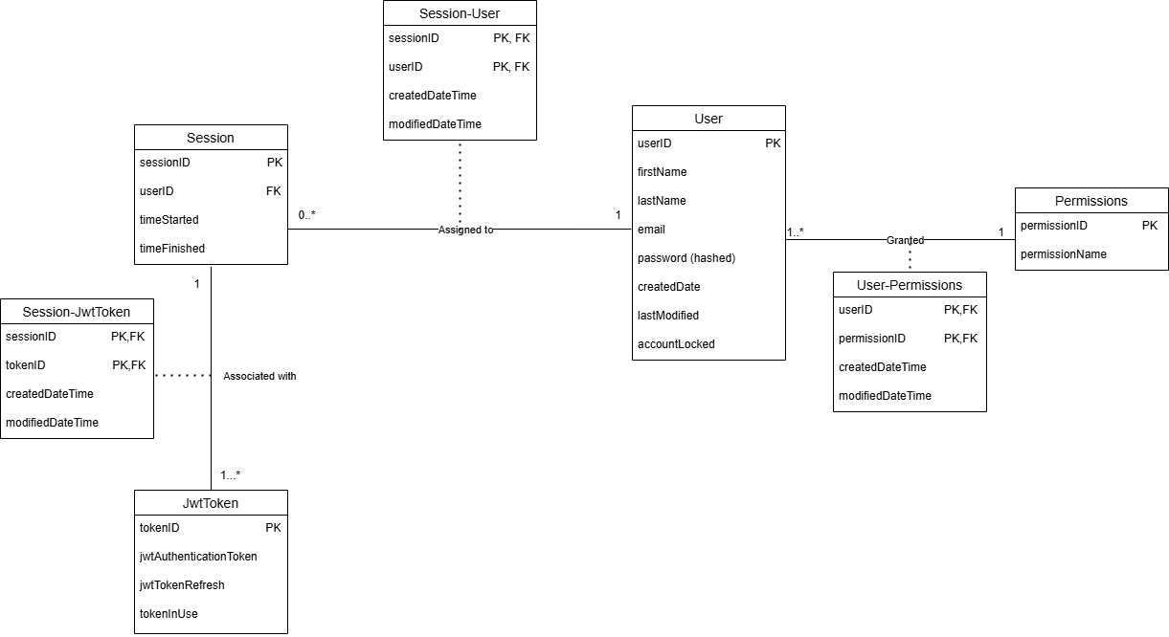
Database Design Diagram – Authentication 1.0

Slide 9
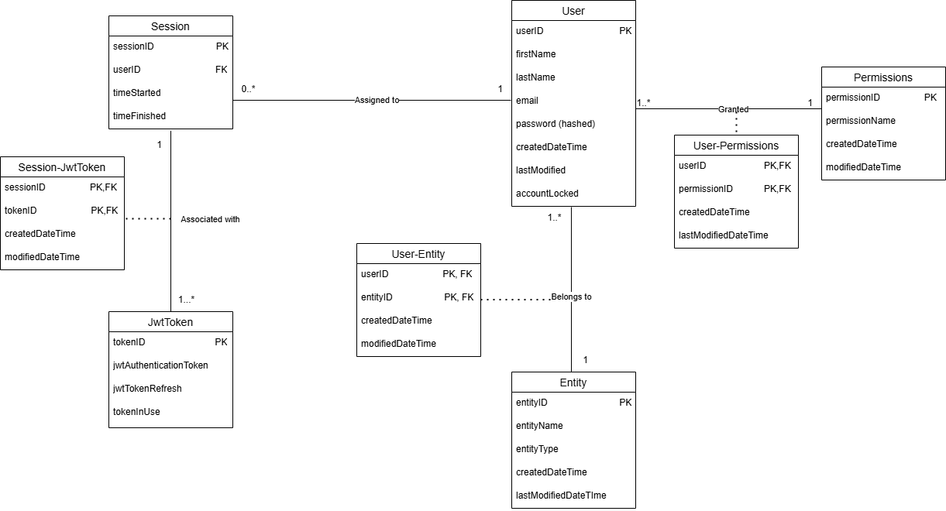
Database Design Diagram – Authentication 1.1

Slide 10
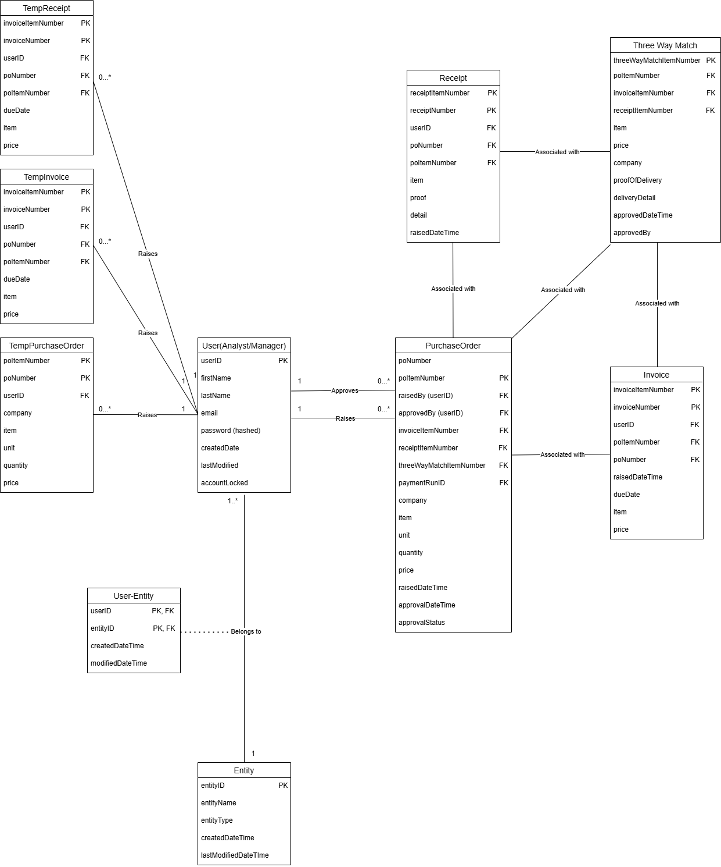
Database Design Diagram –Overall Attempt 1.0

Slide 11
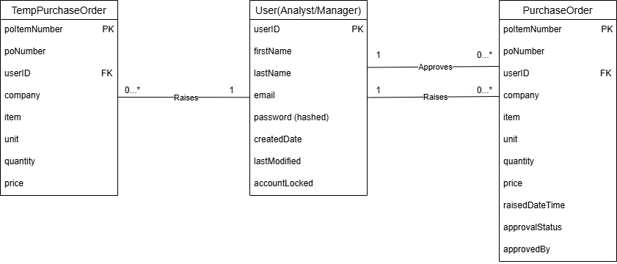
Database Design Diagram – Purchase Order 1.0

Slide 12
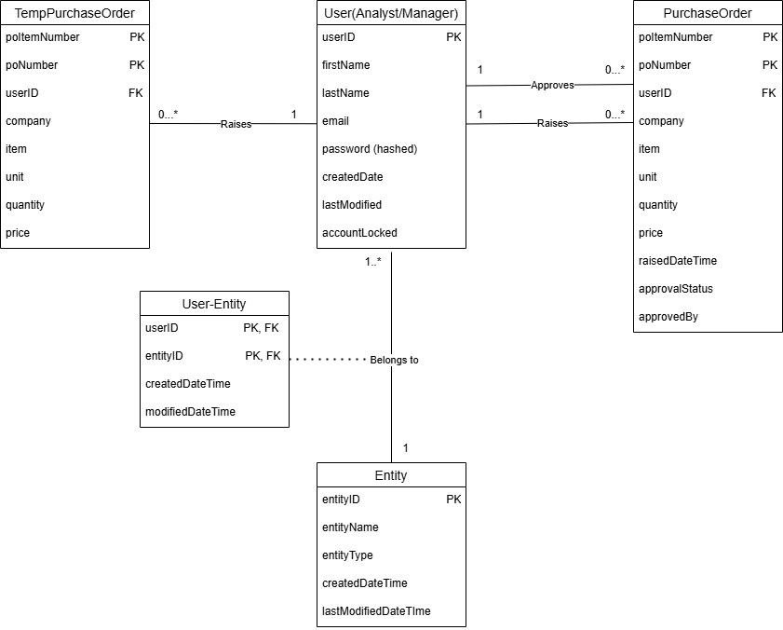
Database Design Diagram – Purchase Order 1.1

Slide 13
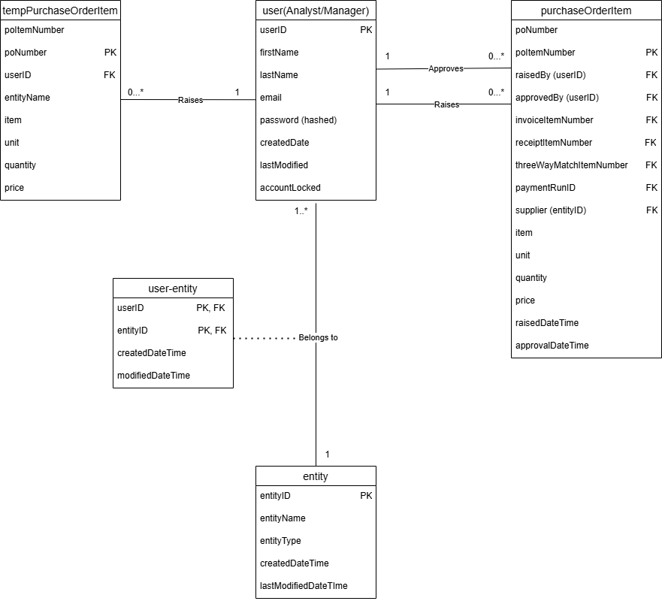
Database Design Diagram – Purchase Order Item 1.2

Slide 14
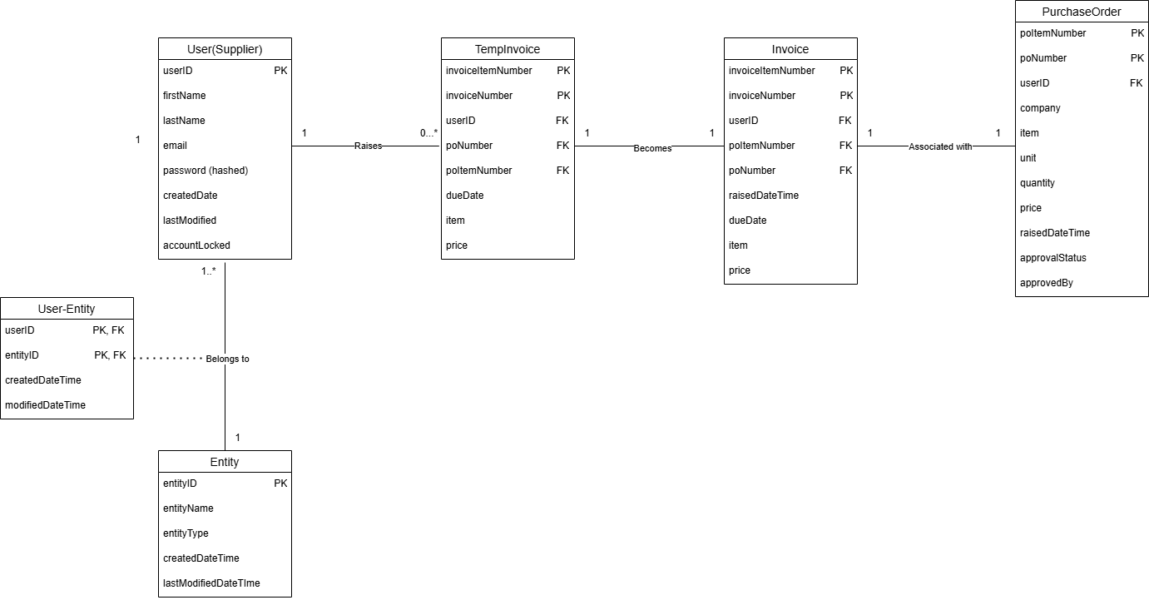
Database Design Diagram – Invoices 1.0

Slide 15
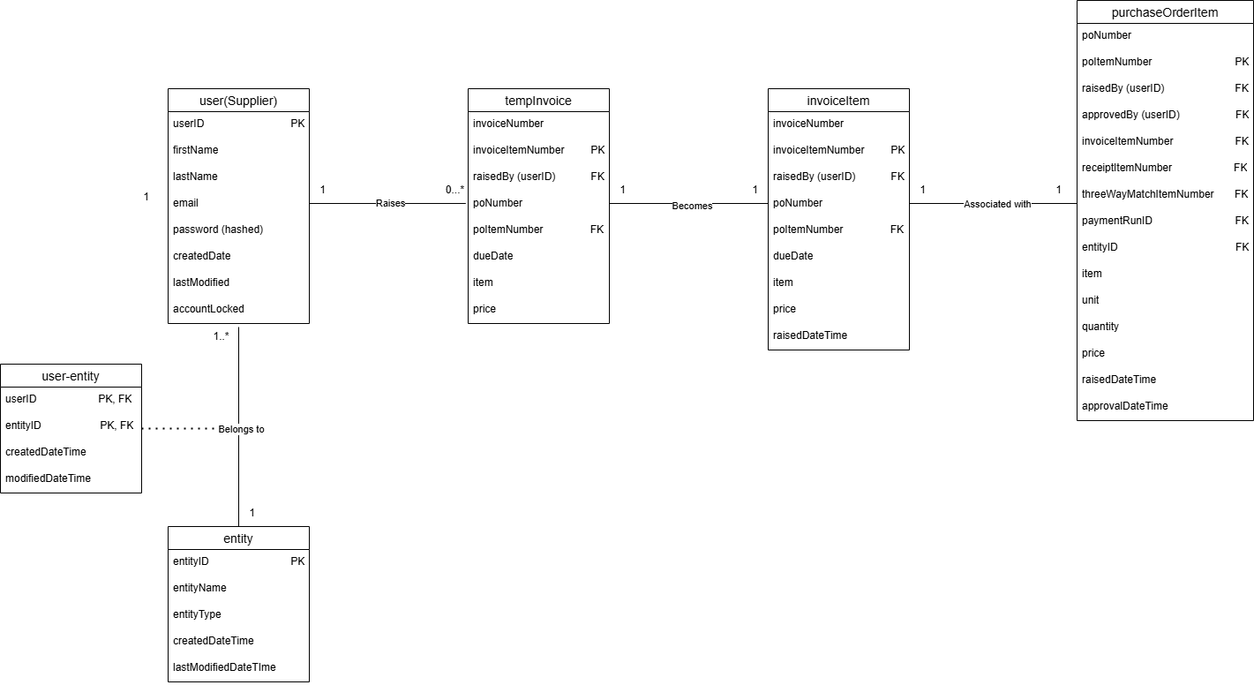
Database Design Diagram – Invoices 1.1

Slide 16
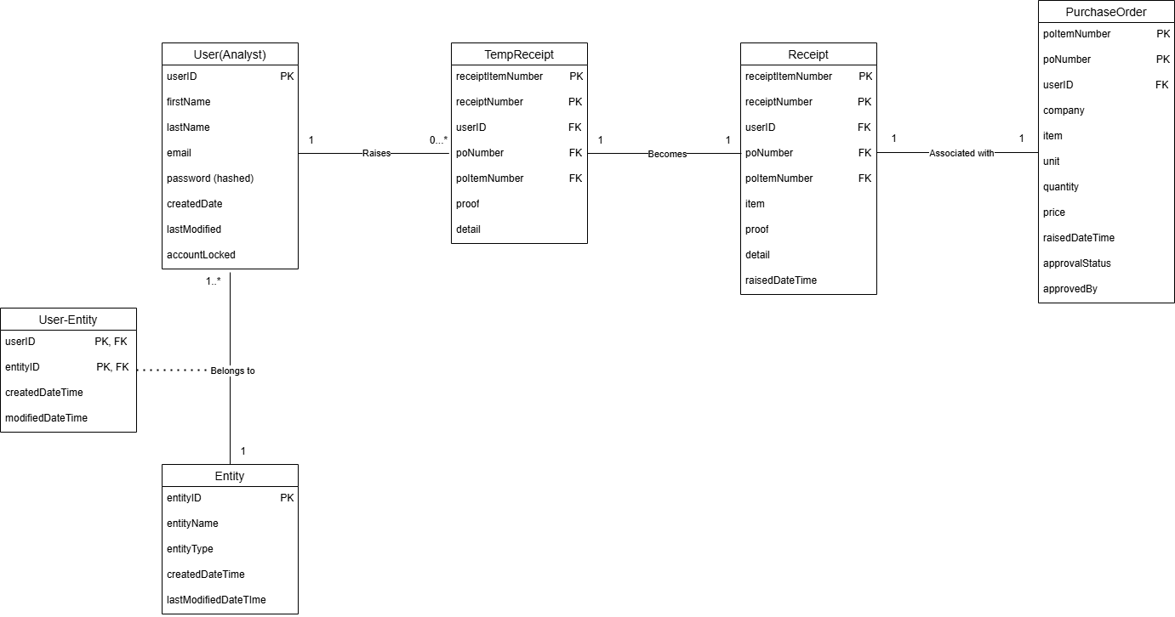
Database Design Diagram – Receipts 1.0

Slide 17

Database Design Diagram – Receipts 1.1

Slide 18
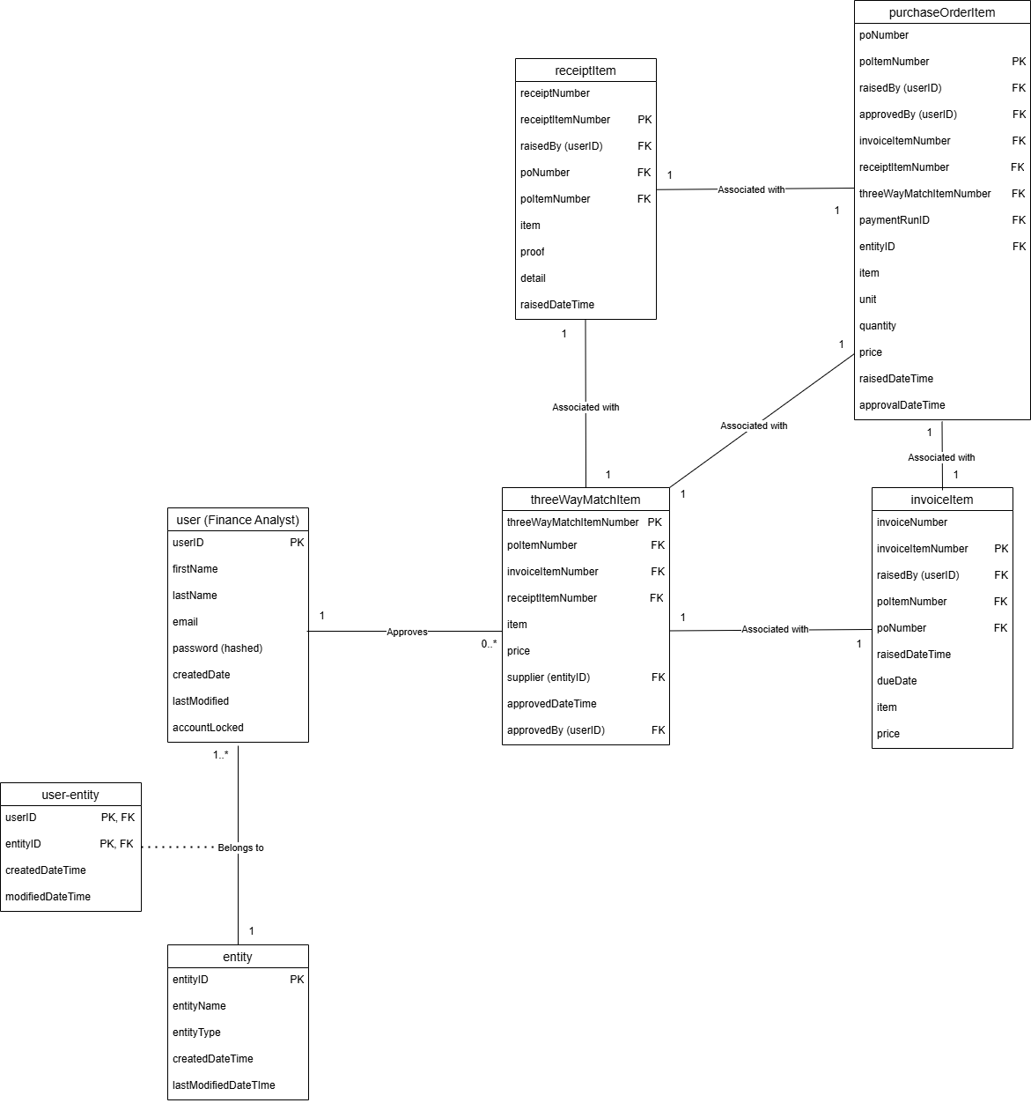
Database Design Diagram – TripleMatching 1.0

Slide 19
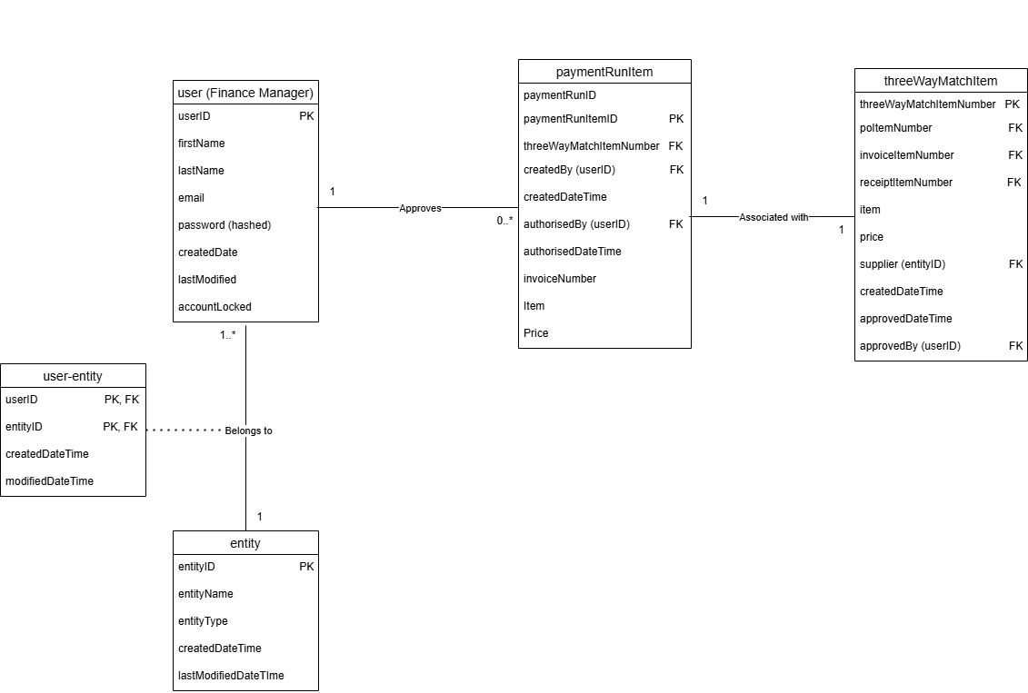
Database Design Diagram – PaymentRuns 1.0

Slide 20
API Sequence Diagram

Slide 21
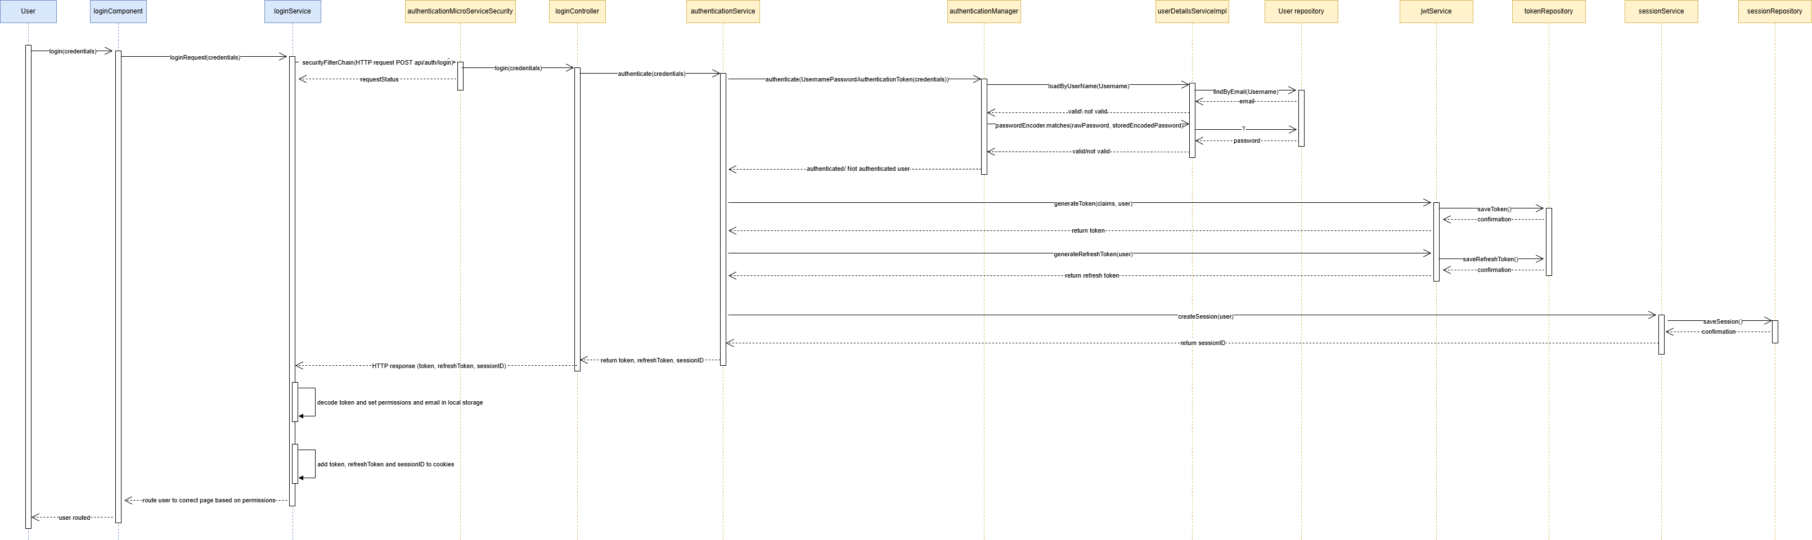
API Sequence Diagram – Authentication Request

Slide 22
API Sequence Diagram – Authentication Request

Slide 23
API Sequence Diagram – Authentication Request

Slide 24
API Sequence Diagram – Authentication Request

